Slide 1
EE-2003 Computer Organization & Assembly Language
INSTRUCTOR
Engr. Aashir Mahboob
Lecturer, Department of Computer Science
FAST NUCES (Karachi)
aashir.mahboob@nu.edu.pk

Slide 2
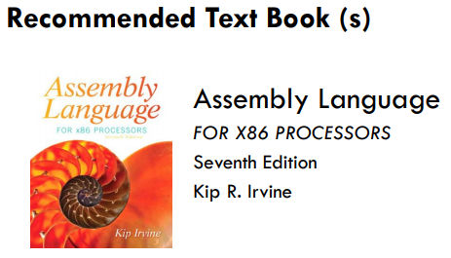
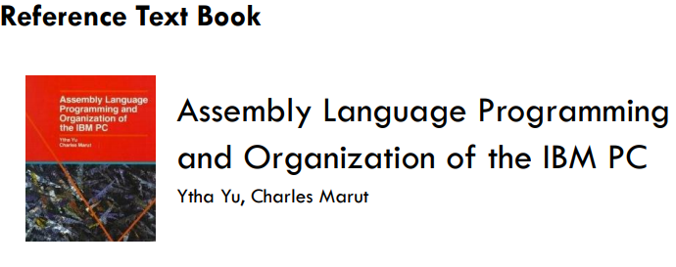

Slide 3
MARKS DISTRIBUTION
Assessment | Weightage
Project | 8%
Assignment | 12%
Midterm Exams | 30%
Final | 50%
Project Proposal → 7th Week → 2 Members/Group → HW/SW
A1- A4. (3rd , 7th , 9th and 13th Week).
M1 & M2 ( 6th & 11th Week).

Slide 4
COURSE OBJECTIVES
Covering the basics of computer organization with emphasis on the lower level abstraction of a computer system
• Programming Methodology of low-level languages, the assembly language.
• Accessing computer hardware directly
• Overview of a user-visible architecture (of Intel 80x86 processors)
• Intel 80x86 instruction set, assembler directives, macro, etc.
• Device handlers
• How is it possible to interface high-level language and low-level language modules

Slide 5
Computer Organization
Computer architecture is concerned with the way hardware components to operate and the way they are connected together to form the computer system.
Computer organization is concerned with the structure and behavior of a computer system as seen by the user.
The computer organization is concerned with the structure and behavior of digital computers.
Working of Internal Parts of Computer. i.e. RAM, CACHE etc.
Computer organization describes how a task is done by the computer.

Slide 6
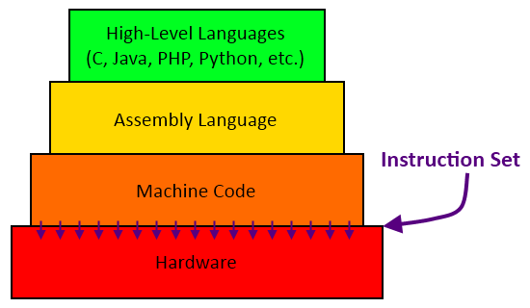
Hierarchy of Languages

Slide 7
High Level Languages
A high-level language (HLL) is a programming language such as C, JAVA, or PYTHON.
It enables a programmer to write programs that are more or less independent of a particular type of computer. (Machine Independent)
Such languages are considered high-level because they are closer to human languages and further from machine languages.
A single statement in C++ expands into multiple assembly language or machine instructions. (one-to-many relationship)

Slide 8
Assembly Language
An assembly language is a low-level programming language designed for a specific type of processor. (Machine Specific)
Assembly language consists of statements written with short mnemonics such as ADD, MOV, SUB, and CALL.
Each assembly language instruction corresponds to a single machine-language instruction. (one-to-one relationship)

Slide 9
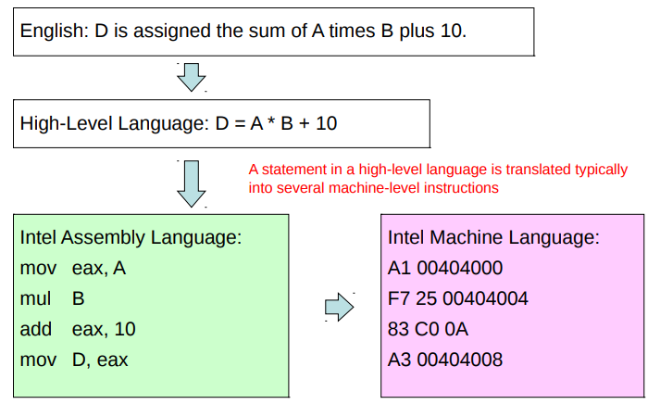
Translating Languages

Slide 10
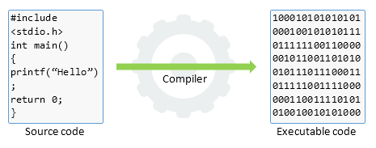
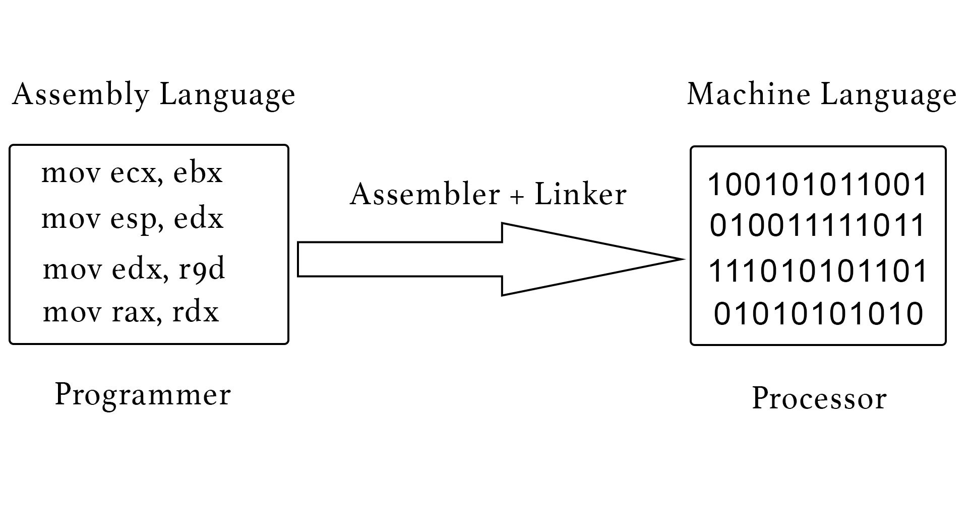
Compiler and Assembler
Compilers translate high-level programs to machine code.(Directly/Indirectly).
Assemblers translate assembly language to machine code.

Slide 11
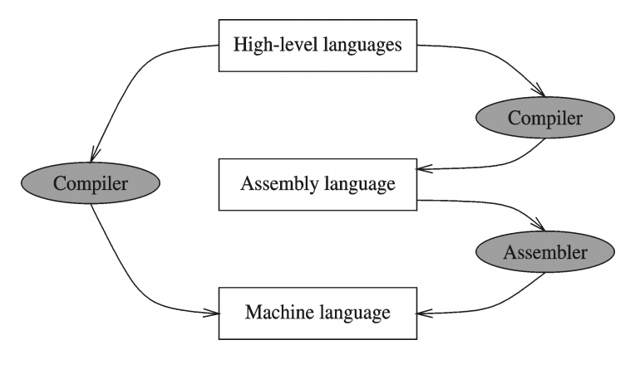
Compiler and Assembler

Slide 12
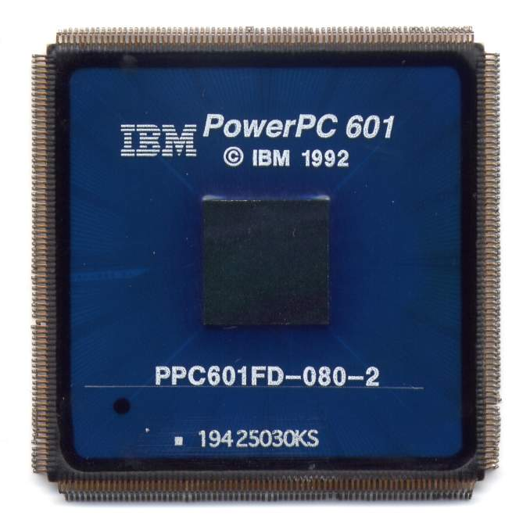
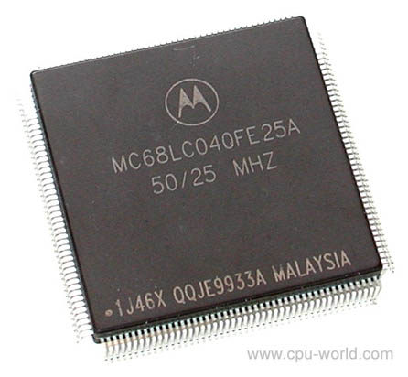
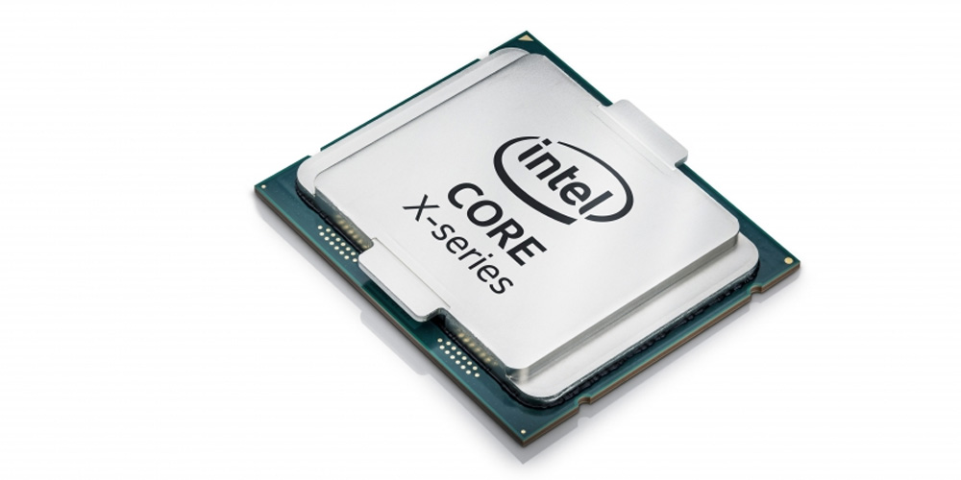
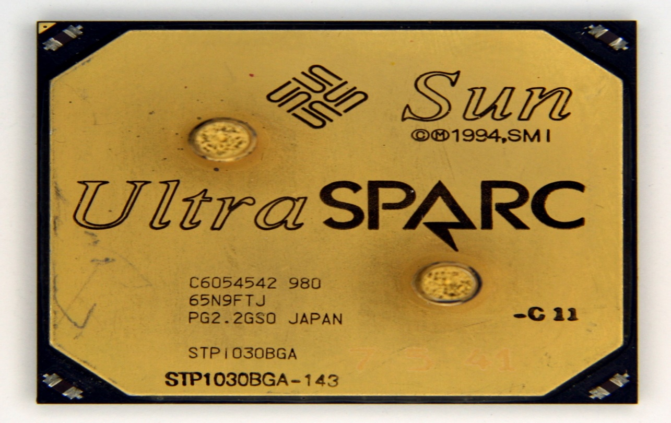
Is Assembly Language Portable?

Slide 13
Is Assembly Language Portable?
A language whose source programs can be compiled and run on a wide variety of computer systems is said to be portable.
A C++ program, for example, should compile and run on just about any computer, unless it makes specific references to library functions that exist under a single operating system.
Assembly language is not portable because it is designed for a specific processor family.

Slide 14
Assembly Language for x86 Processors
Intel stands for “Integrated Electronics”
AMD stands for Advanced Micro Devices.
Assembly Language for x86 Processors focuses on programming microprocessors compatible with the Intel IA-32 and AMD x86 processors running under Microsoft Windows.

Slide 15
Advantages of High-Level Languages
Program development is faster
– High-level statements: fewer instructions to code
Program maintenance is easier
– For the same above reasons
Programs are portable
– Contain few machine-dependent details
● Can be used with little or no modifications on different machines

Slide 16
Why Learn Assembly Language?
Complete control over a system’s resources
- gateway to optimization in speed, offering great efficiency and performance.
Assembly language is transparent
-It has a small number of operations, but it is helpful in understanding the algorithms and other flow of controls. It makes the code less complex and easy debugging as well.
For writing the compilers or device drivers, write some code in assembly language.

Slide 17
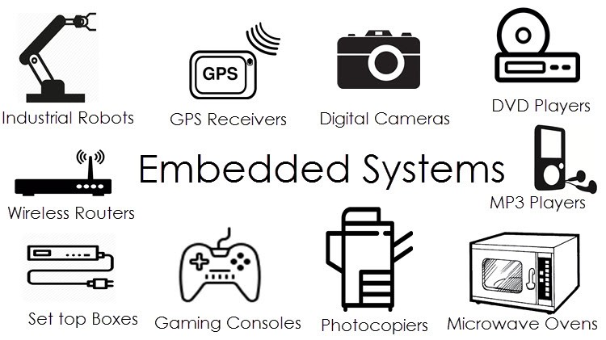
Applications of Assembly Language
Embedded System Programming
Game Programmers → programs to be highly optimized for both space and runtime speed.

Slide 18
Basic Microcomputer Design
The central processor unit (CPU), where calculations and logic operations take place, contains a limited number of storage locations named registers, a high-frequency clock, a control unit, and an arithmetic logic unit.
The memory storage unit is where instructions and data are held while a computer program is running.
The storage unit receives requests for data from the CPU, transfers data from random access memory (RAM) to the CPU, and transfers data from the CPU into memory.
All processing of data takes place within the CPU, so programs residing in memory must be copied into the CPU before they can execute.

Slide 19
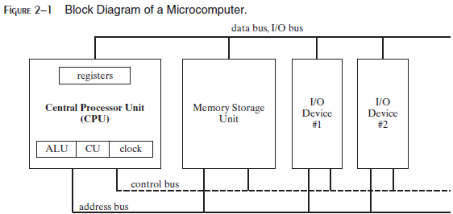
Basic Microcomputer Design
The central processor unit (CPU), where calculations and logic operations take place, contains a limited number of storage locations named registers, a high-frequency clock, a control unit, and an arithmetic logic unit.
The memory storage unit is where instructions and data are held while a computer program is running.

Slide 20
Basic Microcomputer Design
The storage unit receives requests for data from the CPU, transfers data from random access memory (RAM) to the CPU, and transfers data from the CPU into memory.
All processing of data takes place within the CPU, so programs residing in memory must be copied into the CPU before they can execute.

Slide 21
Buses
A bus is a group of parallel wires that transfer data from one part of the computer to another.
A computer system usually contains four bus types: data, I/O, control, and address.
The data bus transfers instructions and data between the CPU and memory.
The I/O bus transfers data between the CPU and the system input/output devices.
The control bus uses binary signals to synchronize actions of all devices attached to the system bus.
The address bus holds the addresses of instructions and data when the currently executing instruction transfers data between the CPU and memory.

Slide 22
Clock Cycles
A machine instruction requires at least one clock cycle to execute.
Few require in excess of 50 clocks (the multiply instruction on the 8088 processor, for example).
Instructions requiring memory access often have empty clock cycles called wait states.
Because of the differences in the speeds of the CPU, the system bus, and memory circuits.

Slide 23
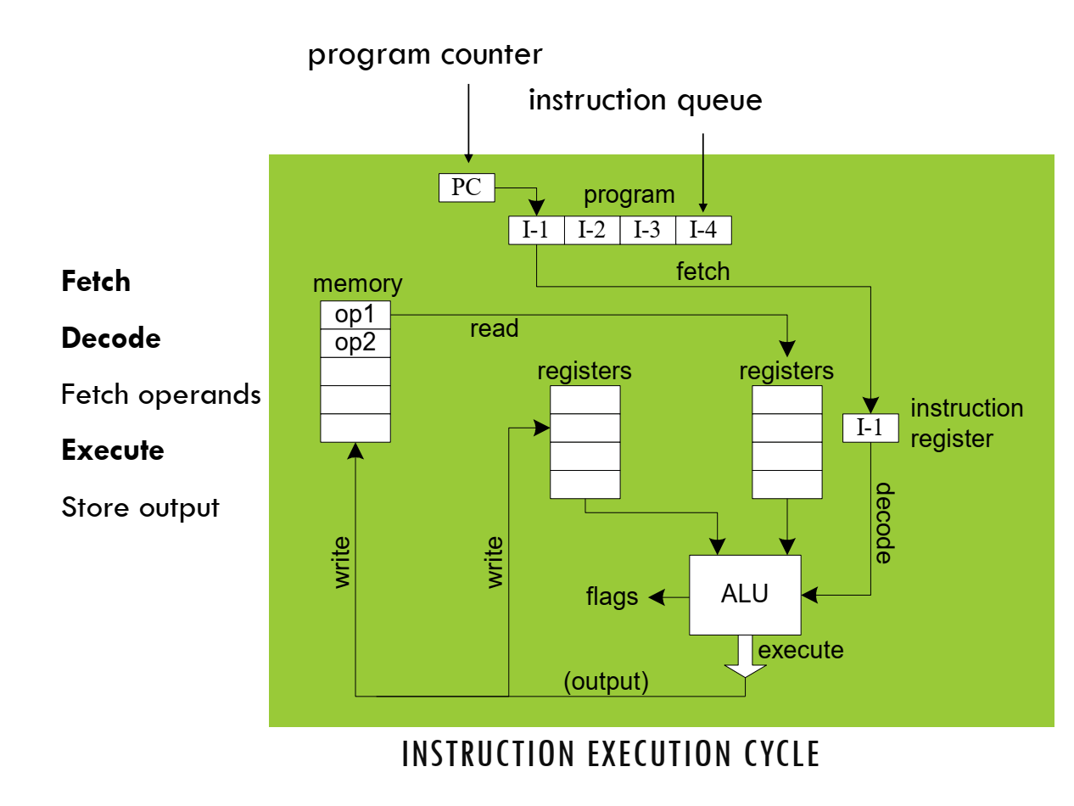
Instruction Execution Cycle

Slide 24
Instruction Execution Cycle
The CPU go through a predefined sequence of steps to execute a machine instruction, called the instruction execution cycle.
The instruction pointer (IP) register holds the address of the instruction we want to execute.
Here are the steps to execute it:
First, the CPU has to fetch the instruction from an area of memory called the instruction queue. It then increments the instruction pointer.
Next, the CPU decodes the instruction by looking at its binary bit pattern.
This bit pattern might reveal that the instruction has operands (input values).
If operands are involved, the CPU fetches the operands from registers and memory.
Sometimes, this involves address calculations.
Next, the CPU executes the instruction, using any operand values it fetched during the earlier step. It also updates a few status flags, such as Zero, Carry, and Overflow.
Finally, if an output operand was part of the instruction, the CPU stores the result of its execution in the operand.

Slide 25
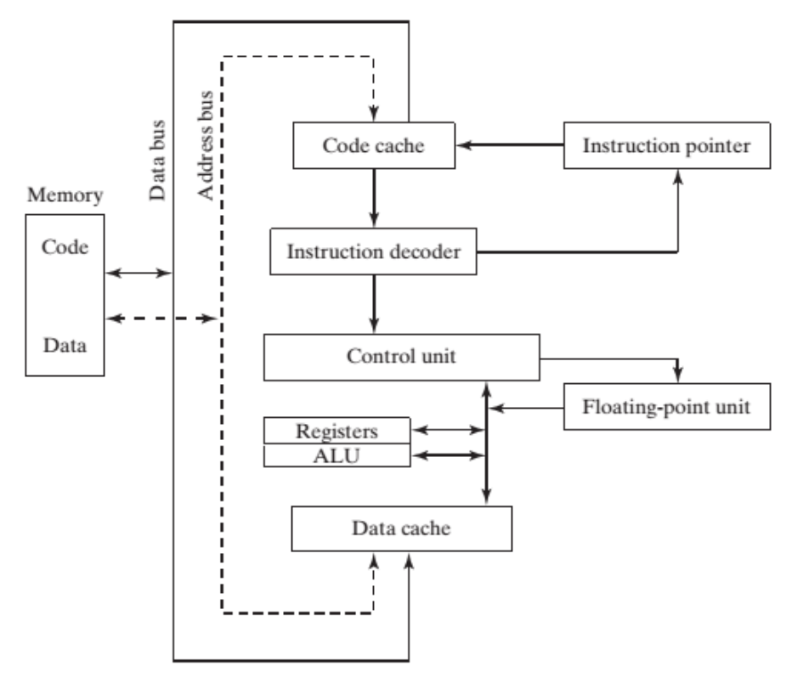
Instruction Execution Cycle

Slide 26
Instruction Execution Cycle
An operand is a value that is either an input or an output to an operation.
For example, the expression Z = X + Y has two input operands (X and Y) and a single output operand (Z).
In order to read program instructions from memory, an address is placed on the address bus.
Next, the memory controller places the requested code on the data bus, making the code available inside the code cache.
The instruction pointer’s value determines which instruction will be executed next.
The instruction is analyzed by the instruction decoder, causing the appropriate digital signals to be sent to the control unit, which coordinates the ALU and floating-point unit.
Control bus carries signals that use the system clock to coordinate the transfer of data between different CPU components.

Slide 27
Reading from Memory
As a rule, computers read memory much more slowly than they access internal registers.
Reading a single value from memory involves four separate steps:
Place the address of the value you want to read on the address bus.
Assert (change the value of) the processor’s RD (read) pin.
Wait one clock cycle for the memory chips to respond.
Copy the data from the data bus into the destination operand.
Each of these steps generally requires a single clock cycle.

Slide 28
Cache
CPU designers figured out that computer memory creates a speed bottleneck because most programs have to access variables.
To reduce the amount of time spent in reading and writing memory the most recently used instructions and data are stored in high-speed memory called cache.
The idea is that a program is more likely to want to access the same memory and instructions repeatedly, so cache keeps these values where they can be accessed quickly.
When the CPU begins to execute a program, it loads the next thousand instructions (for example) into cache, on the assumption that these instructions will be needed in the near future.
If there happens to be a loop in that block of code, the same instructions will be in cache.
When the processor is able to find its data in cache memory, we call that a cache hit.
On the other hand, if the CPU tries to find something in cache and it’s not there, we call that a cache miss.

Slide 29
X86 family Cache types
Cache memory for the x86 family comes in two types.
Level-1 cache (or primary cache) is stored right on the CPU.
Level-2 cache (or secondary cache) is a little bit slower, and attached to the CPU by a high-speed data bus.

Slide 30
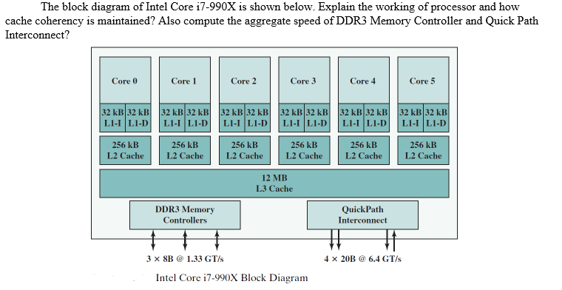

Slide 31
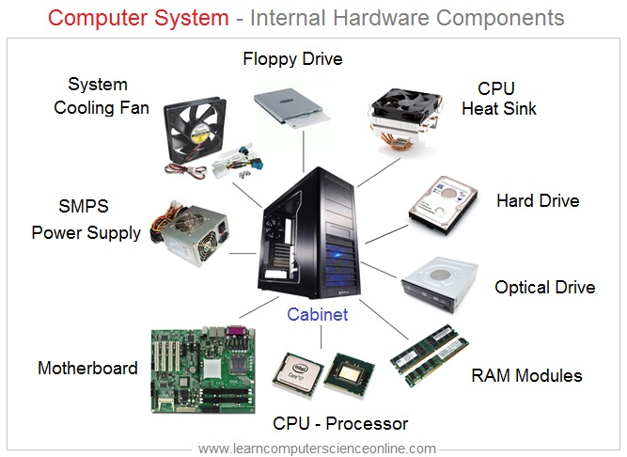
Virtual Machine Concept
Computers are Build with Physical Parts i.e. Hardware

Slide 32






Virtual Machine Concept
SOFTWARES → Makes Computer easy to use.

Slide 33
Virtual Machine Concept
OPERATING SYSTEM SOFTWARES
They are able to control Physical Components of Computer i.e. HARDWARE

Slide 34

Virtual Machine Concept
VIRTUAL MACHINE MANAGER (HYPERVISOR)
Software → allows to run → an Operating System → Within another Operating System.

Slide 35
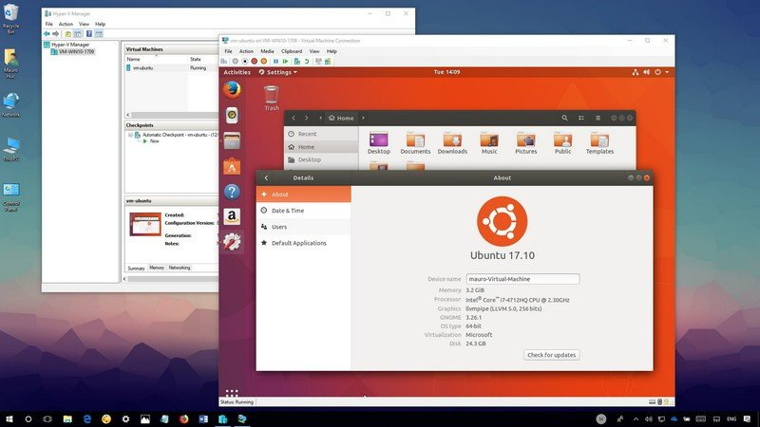
Virtual Machine Concept

Slide 36
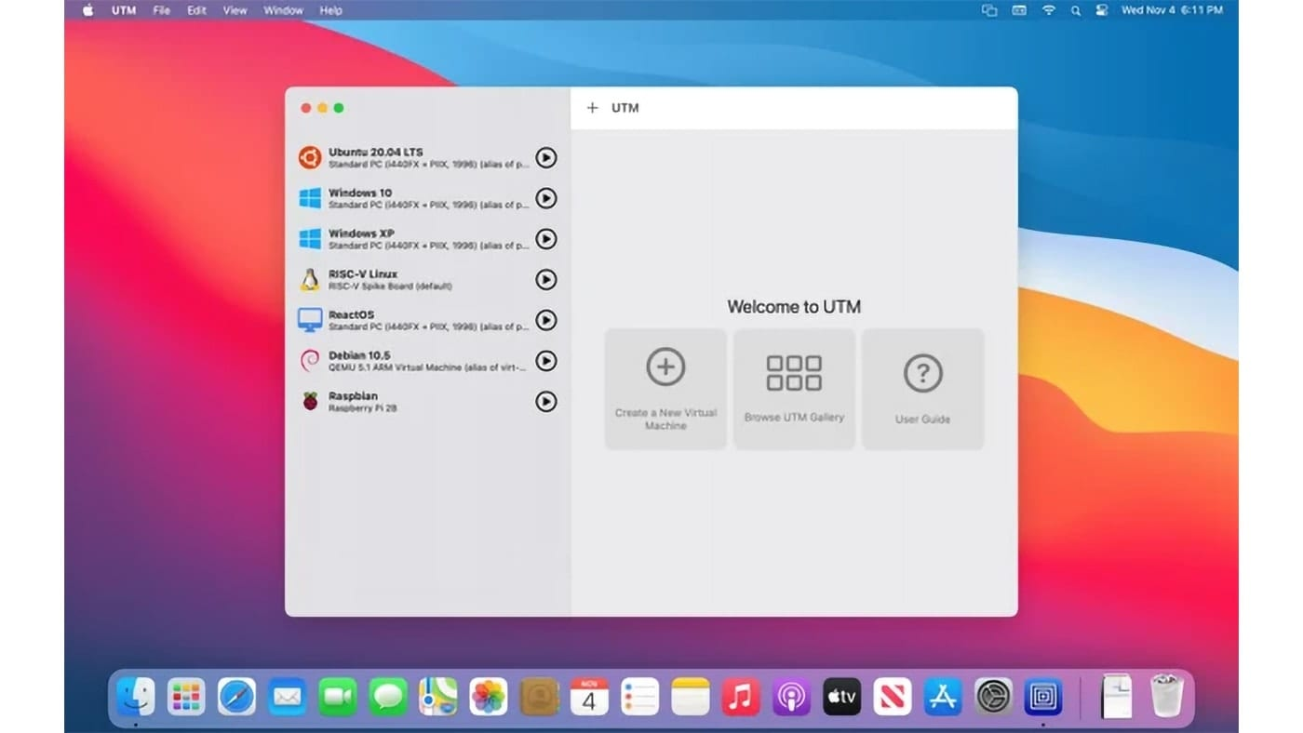
Virtual Machine Concept

Slide 37

Virtual Machine Concept

Slide 38
Virtual Machine Concept
A virtual machine (VM) is an image file managed by the hypervisor that exhibits the behavior of a separate computer, capable of performing tasks such as running applications and programs like a separate computer.
In other words, a VM is a software application that performs most functions of a physical computer, actually behaving as a separate computer system.
A virtual machine, usually known as a guest, is created within another computing environment referred as a "host." Multiple virtual machines can exist within a single host at one time.

Slide 39
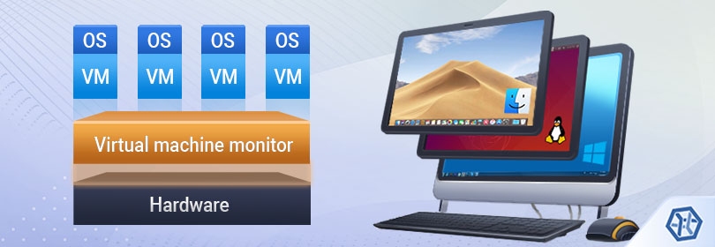
Virtual Machine Concept

Slide 40
Virtual Machine Concept
Programming Language analogy:
Each computer has a native machine language (language L0) that runs directly on its hardware
A more human-friendly language is usually constructed above machine language, called Language L1
The virtual machine VM1, can execute commands written in language L1.
The virtual machine VM0 can execute commands written in language L0

Slide 41
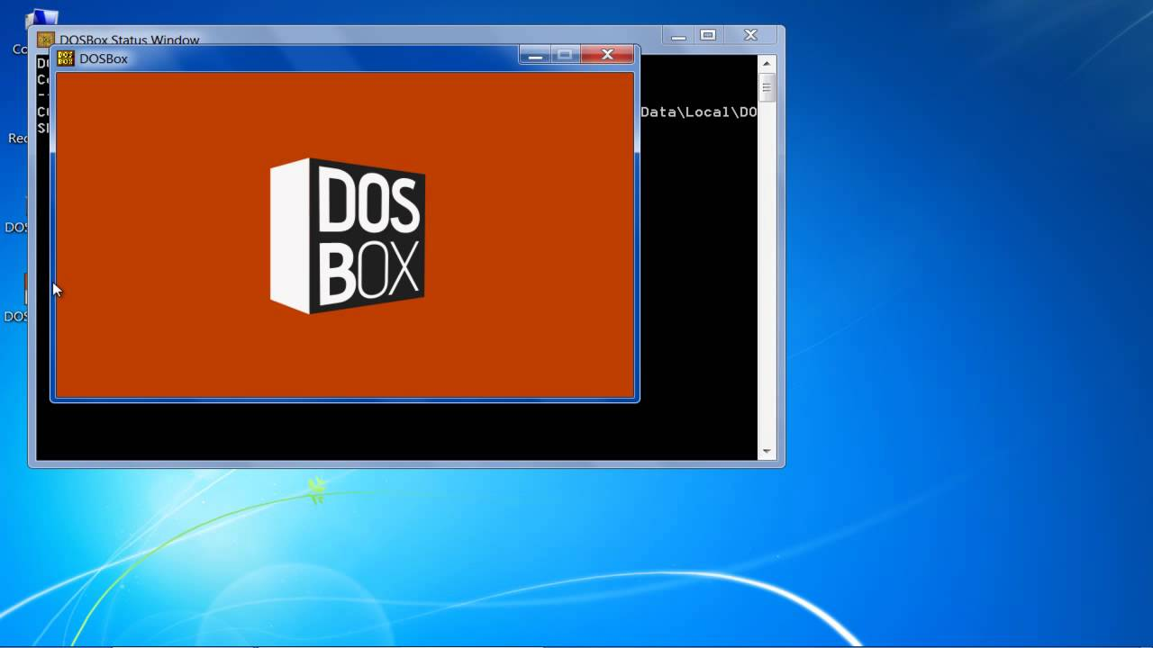
Virtual Machine Concept
The virtual machine VM0 can execute commands written in language L0

Slide 42
Virtual Machine Concept
The Java programming language is based on the virtual machine concept.
A program written in the Java language is translated by a Java compiler into Java byte code - a low-level language quickly executed at runtime by a program known as a Java virtual machine (JVM).

Slide 43
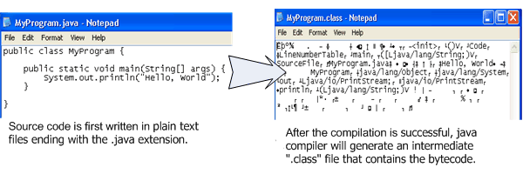
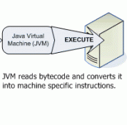
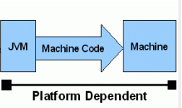
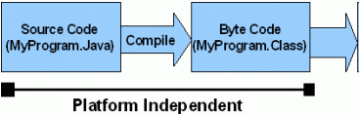
Interpret
Java code / Bytecode is always the same on different OS. That makes java program as platform independent.
JVM is platform dependent that means there are different implementation of JVM on different OS.

Slide 44
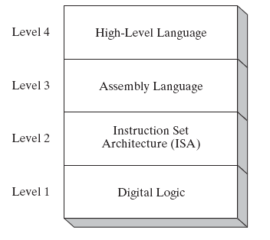
Specific Machine Levels
(descriptions of individual levels follow . . . )

Slide 45
High-Level Language
Level 4
Application-oriented languages
C++, Java, Pascal, Visual Basic . . .
Programs compile into assembly language (Level 3)

Slide 46
Assembly Language
Level 3
Instruction mnemonics that have a one-to-one correspondence to machine language
Programs are translated into Instruction Set Architecture Level - machine language (Level 2)
The instructions in assembly language may directly match the computer’s architecture or they may be translated during execution by a program inside the processor known as a microcode interpreter.

Slide 47
Instruction Set Architecture (ISA)
Level 2
Also known as conventional machine language.
Executed by Level 1 (Digital Logic).

Slide 48
Digital Logic
Level 1
CPU, constructed from digital logic gates
System bus
Memory
Implemented using bipolar transistors

Slide 49


